Slide 1
EVA-Project M2O evaluation
Sprint 1(O periodo) (fecha ini –fecha fin)

Slide 2
Sprint I Scope
Analyze EVA project
Evaluation Services
Templates Services
EVA ui-app
Evaluation flow
Implement CRUD 360 evaluations (M2O)
Title only
Setup Continuous Integration concept
Using Docker and GitLab

Slide 3
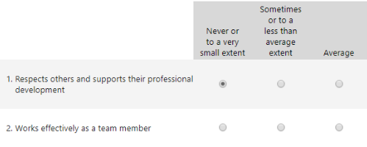
What is a 360 evaluation (M2O)?
Evaluation method & tool provides the opportunity to receive performance feedback.
Evaluated by multiple people, many opinions
Ubiquitous language: 360 evaluation -> M20 evaluation

Slide 4
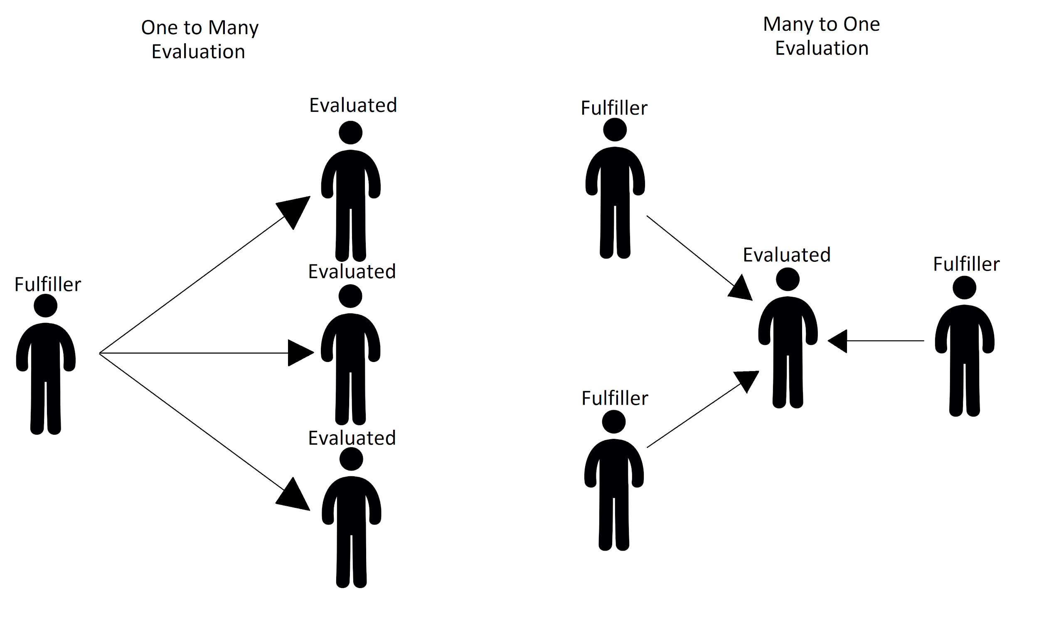
One to Many evaluations and Many to One evaluations
M2O Characteristics:
Single Choice answers
There are no wrong answers - soft skills
Can be taken by many people at the same time

Slide 5
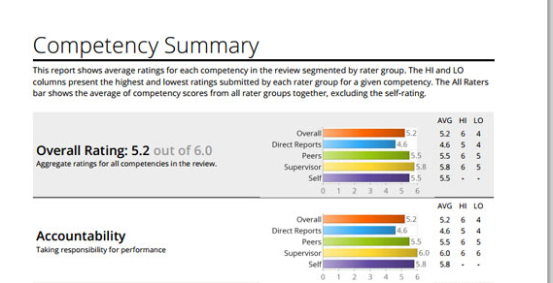
360
EVALUATION
REPORT

Slide 6
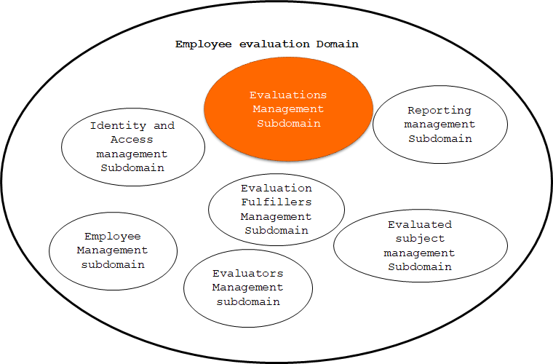
Domain Driven Design (DDD) EVA - Project

Slide 7
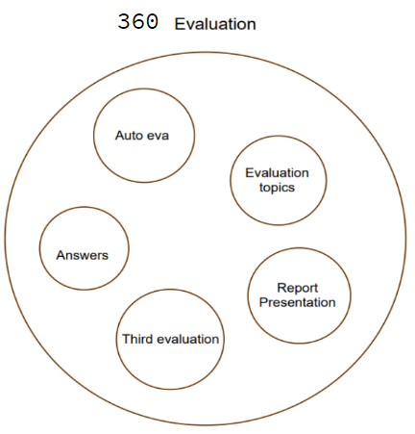
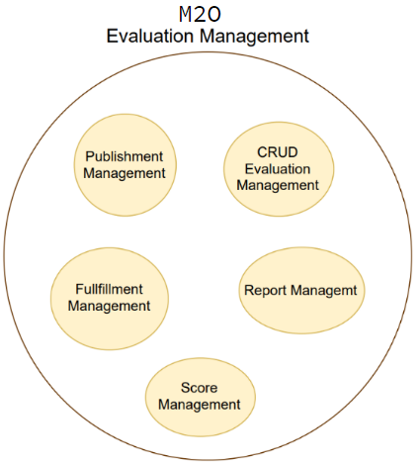

DDD M2O Evaluation
v0
v1

Slide 8
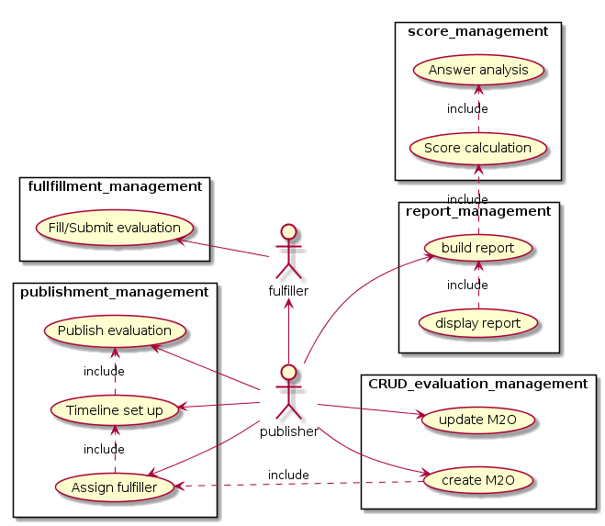
Use Case Diagram

Slide 9
SPRINT I

Slide 10
DEFINITION OF READY
DEFINITION OF DONE
Defined
Sized
Description
Code Review by co-worker
Accomplish the acceptance criteria
Unit Testing (TDD)

Slide 11
Main User Stories
As a developer I should be able to create a RAML specification.
As a developer I should be able to start the EVA platform on my local environment
As a devop user I should have CI/CD for the project
As a user I should be able to create/read/list/update/delete a M2O evaluation title only

Slide 12
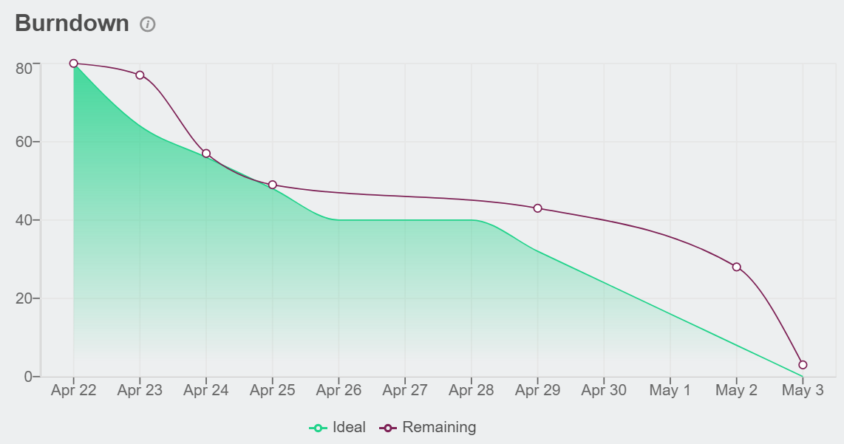
Burndown Chart
Migration of the framework of the evaluation service
Change the version of the IDE (VS2017 -> VS 2019)
Problems with the virtual machine
Adequation to the development standards
Angular & Docker deep learning
Story Points:
Feature: 22
Chore: 51
Total: 73
User Stories: 20
Velocity: 8,1 points per day.

Slide 13
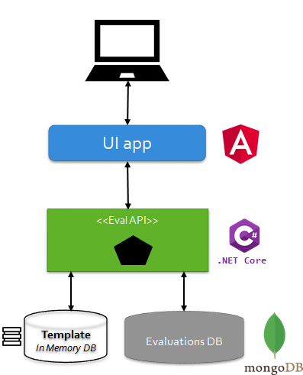
SOFEA (Service Oriented Front End Architecture)

Slide 14
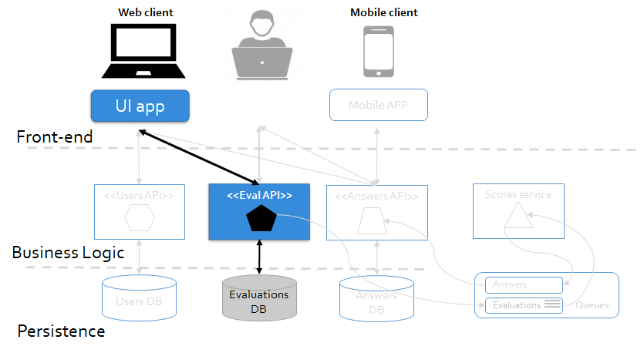
Architecture

Slide 15
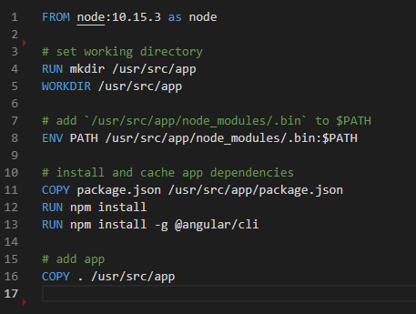


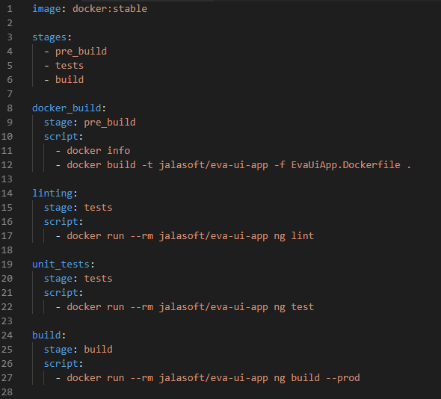
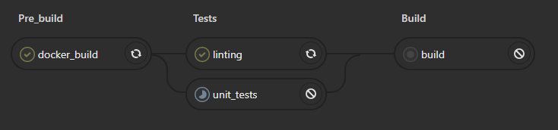
Continuous Integration
EvaUiApp.Dockerfile
.gitlab-ci.yml

Slide 16
DEMO

Slide 17
Thank you!

Slide 18
Questions
Will the results be shown on the screen or should they be printed on a .PDF file?
Will the results be available during the evaluation time, or only at the end?
Who can see the report, publisher and the evaluated or only publisher?
The process of the results analysis will be on demand or automatic?

Slide 19
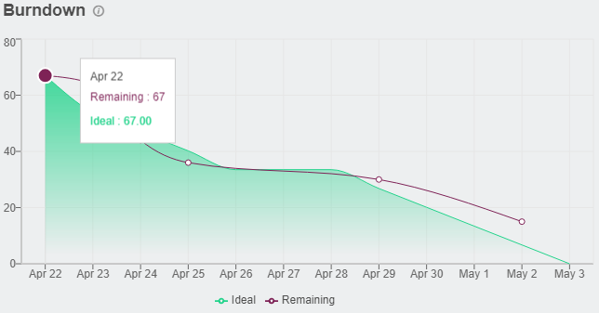
Burndown Chart
User stories:
As a developer I should be able to create a RAML specification.
As a developer I should be able to start the EVA platform on my local environment
As a devop user I should have CI/CD for the project
As a user I should be able to create/read/list/update/delete a 360 evaluation

Slide 20
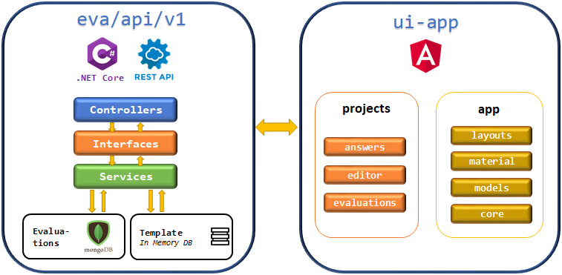
Architecture

Slide 21
Retrospective
Migration of the framework of the evaluation service
Problems with the virtual machine
Change the version of the IDE (VS2017 -> VS 2019)
Adequation to the development standards
Angular & Docker deep learning

